Slide 1

Regime Aware Portfolio Optimization
By,
Abhilasha H A
Intern Data Insight Analyst

Slide 2
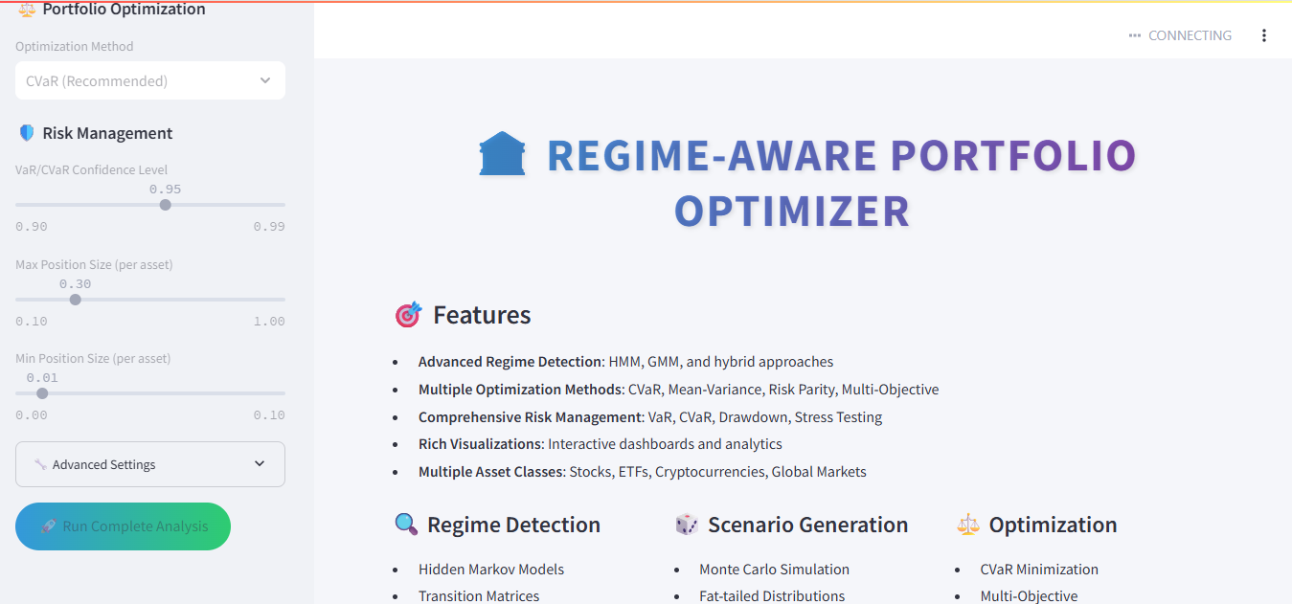

Slide 3
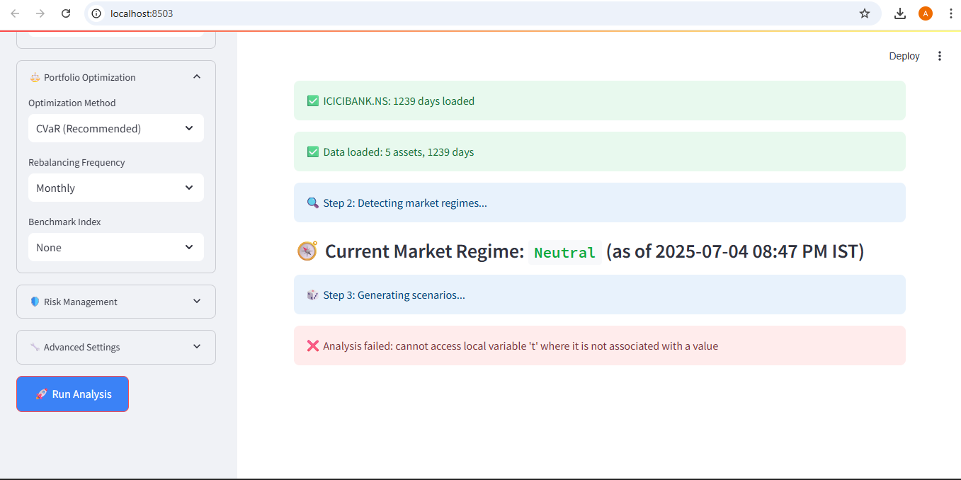

Slide 4
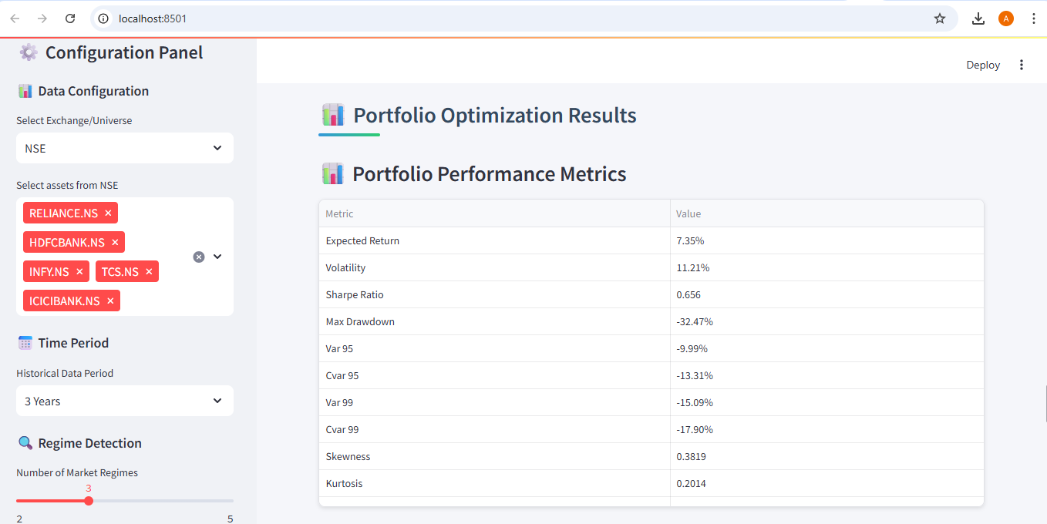

Slide 5
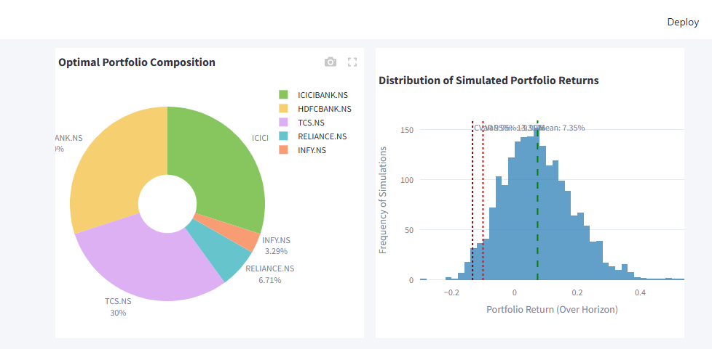

Slide 6
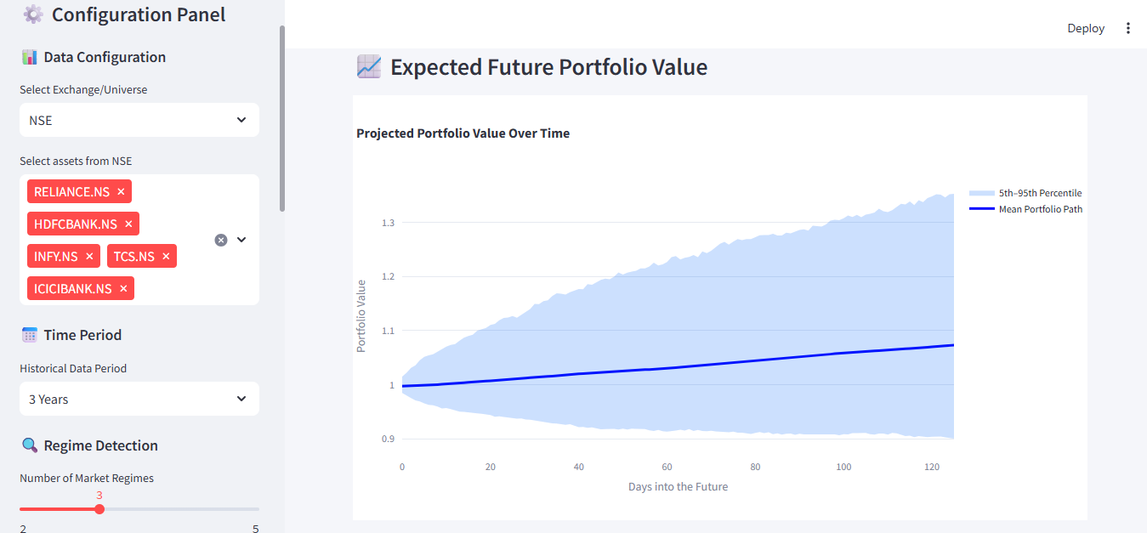

Slide 7
